Slide 1

MLB Starting Pitching Rotations Analysis

Slide 2
Project Goal
The goal of this project was to analyze starting pitching rotations in the MLB to determine which types of rotations have been the most successful over the past ten seasons
In order to analyze these starting pitching rotations, I decided to examine the different styles of the pitchers that make them up

Slide 3
Clustering SP’s by Style
In order to examine the different styles of starting pitcher that have existed in the MLB over the past ten seasons, I decided to use k-means clustering

Slide 4
Data
In order to perform k-means clustering on MLB starting pitchers from the last ten seasons, I decided to only use features that were representative of the pitcher’s style of pitching, while attempting to exclude features that only measured his “success”
This included metrics such as Effective Velocity, Average Velocity per type of pitch (Fastball, Curveball, etc..), percentage of time throwing each pitch type (Fastball%, Curveball%, etc..), Pace, Strike Percentage, First-Strike Percentage, Standardized Runs Saved per type of pitch, and others

Slide 5
Data
I gathered the selected data for all MLB pitchers who pitched at least 100 total innings from the start of the 2010 season through the end of the 2019 season (data was obtained from fangraphs.com)

Slide 6
Missing Data
Because not all MLB starting pitchers throw the same types of pitches, there were quite a few missing values in the data for metrics that were pitch type dependent, such as Standardized Runs saved per type pitch and Average Velocity per type of pitch
I believed these were important features to use in the clustering, so rather than get rid of them, I decided to find a way to impute these missing values

Slide 7
Imputation via MICE
MICE stands for Multivariate Imputation by Chained Equations, and it is a way to assign values to the missing values in the data based off other values in the data
MICE assumes that the data is “Missing at Random”
While some may argue that this is not the case, I am going to make the assumption that certain pitchers being able to throw Sinkers rather than Cutters, or vice versa, is a random occurrence and not the result of other attributes

Slide 8
Standardization
After performing missing value imputation on the dataset, I standardized the data to make sure that all features were given the same weight during k-means clustering

Slide 9
Choosing k
In order to choose the optimal value of k for k-means clustering, I used both the Elbow Method, which measures total within-cluster sum of squares, and Silhouette Analysis, which measures how far apart clusters are from each other

Slide 10
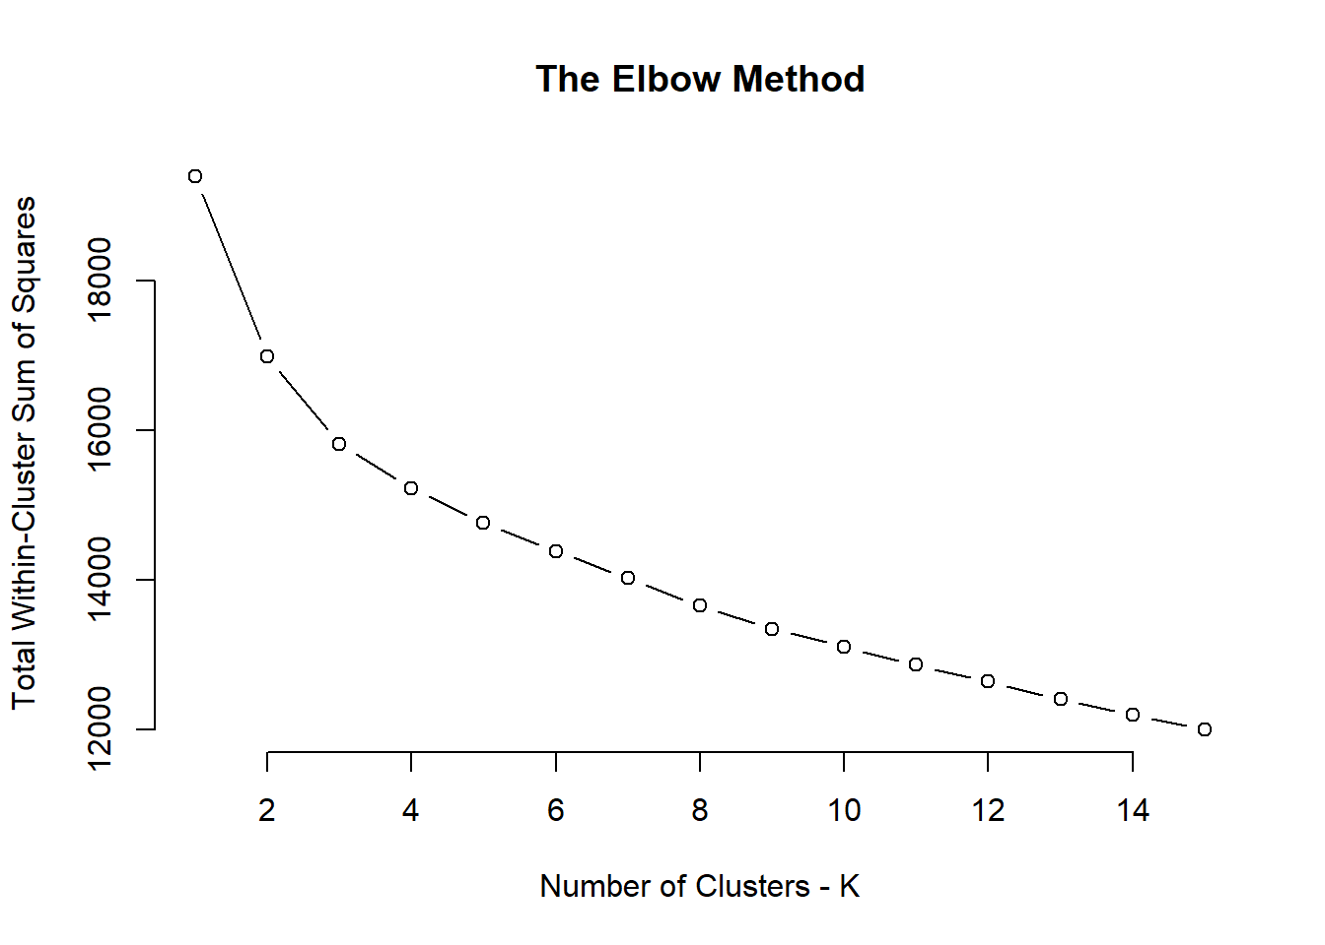

Slide 11
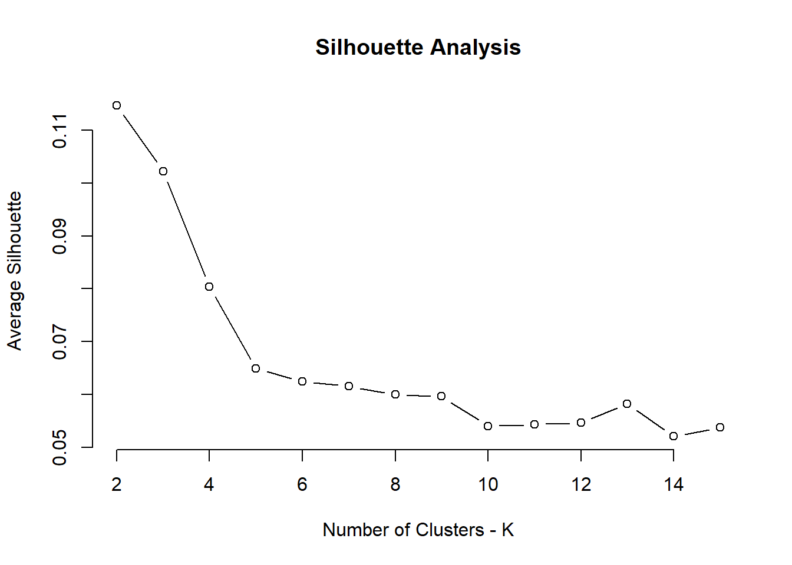

Slide 12
Cluster-Wide Means for Key Metrics
 | Strike % | First-Strike % | Swing-Strike % | Pace (sec) | FB % | CH % | CB % | SL % | wFB/C | wCH/C | wCB/C | wSL/C | FB Velo | CH Velo | CB Velo | SL Velo
Cluster 1 | 0.44 | 0.61 | 0.10 | 22.9 | 0.56 | 0.12 | 0.12 | 0.17 | -0.12 | -0.45 | -0.33 | 0.40 | 93.00 | 85.29 | 78.53 | 84.82
Cluster 2 | 0.45 | 0.62 | 0.08 | 21.3 | 0.54 | 0.16 | 0.11 | 0.14 | -0.30 | -0.31 | -0.42 | -0.62 | 89.24 | 80.84 | 74.23 | 81.41
Cluster 3 | 0.44 | 0.59 | 0.07 | 21.6 | 0.58 | 0.12 | 0.13 | 0.12 | -0.64 | -0.89 | -0.86 | -0.60 | 91.11 | 83.52 | 77.11 | 84.44
Cluster 1: “Power” Pitchers
Cluster 2: “Control” Pitchers
Cluster 3: “Standard” Pitchers

Slide 13
SP Effectiveness by Cluster
After clustering all of the starting pitchers into three distinct clusters, I examined the success of each cluster using the metrics of Skill-Interactive Earned Run Average (SIERA) and Expected Fielding Independent Pitching (xFIP)

Slide 14
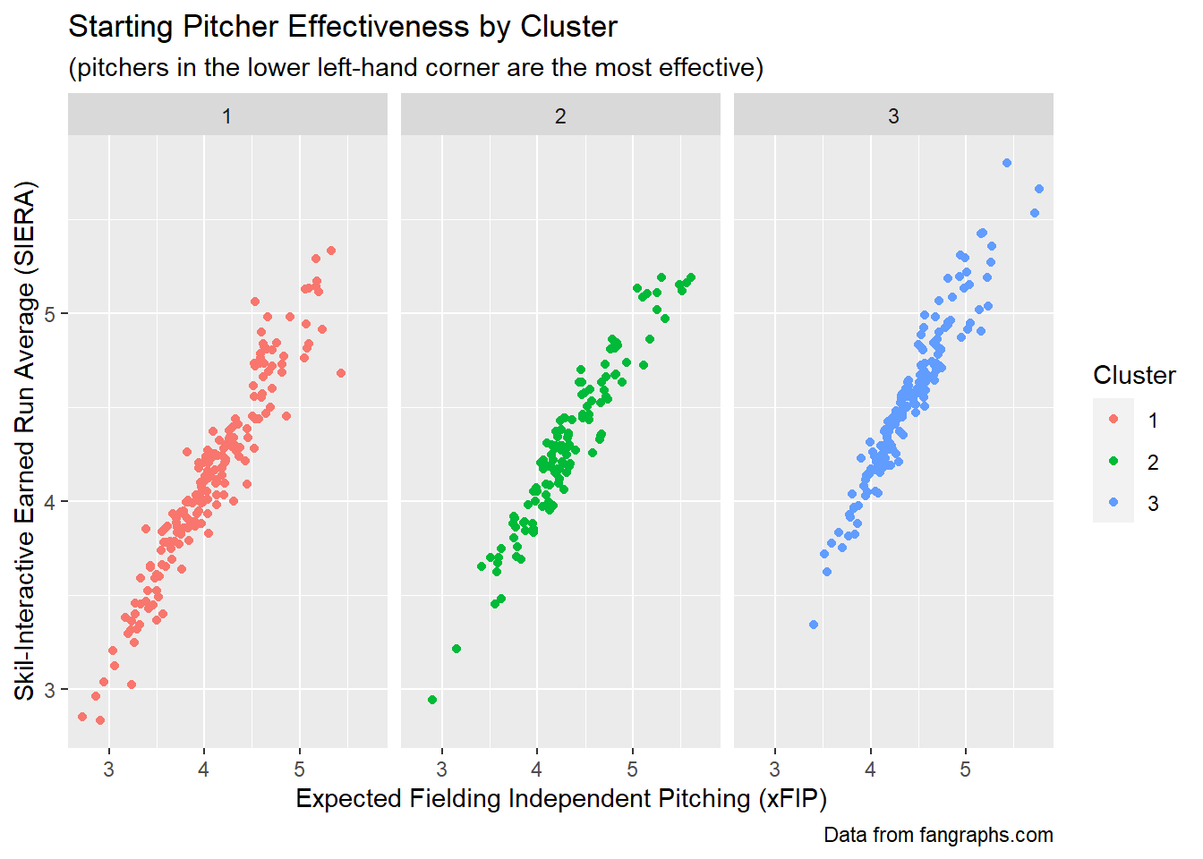

Slide 15
Examining Rotations by Composition
Now that the k-means clustering has been performed on the dataset of starting pitchers, the next step will be to examine the compositions of different starting pitching rotations based on the three clusters

Slide 16
Data
I looked at data for all 300 MLB starting pitching rotations from the 2010 season through the 2019 season, and if the rotation consisted of at least five players who pitched at least 100 innings during that time frame, I counted the number of that rotation’s top five starting pitchers (by innings pitched) that fell into each of the three clusters
I also collected the number of wins, as well as the season-long starting pitching SIERA and xFIP for each of these teams (data was obtained from frangraphs.com and baseball-reference.com)

Slide 17
Encoding SP Rotation Compositions
After counting the number of each type of pitcher in each starting pitching rotation, I encoded the composition of each rotation using a 3-digit key
The first digit represented the number of pitchers in the 5-man starting pitching rotation belonging to Cluster 1 (“Power” Pitchers), the second digit represented the number of pitchers in the rotation belonging to Cluster 2 (“Control” Pitchers), and the third digit represented the number of pitchers in the rotation belonging to Cluster 3 (“Standard” Pitchers)

Slide 18
Grouping SP Rotations by Composition
The next step was to group the starting pitching rotations by their 3-digit composition keys
Example: A key of “212” means that that starting pitching rotation consists of 2 “Power” pitchers, 1 “Control” pitcher, and 2 “Standard” pitchers
After this, I removed all starting pitching rotation compositions that occurred less than five times over the past ten seasons

Slide 19
Measuring Success of SP Rotation Compositions
Next, I used team wins, starting pitching SIERA, and starting pitching xFIP to attempt to measure the relative success of each of the different types of starting pitching rotation compositions

Slide 20
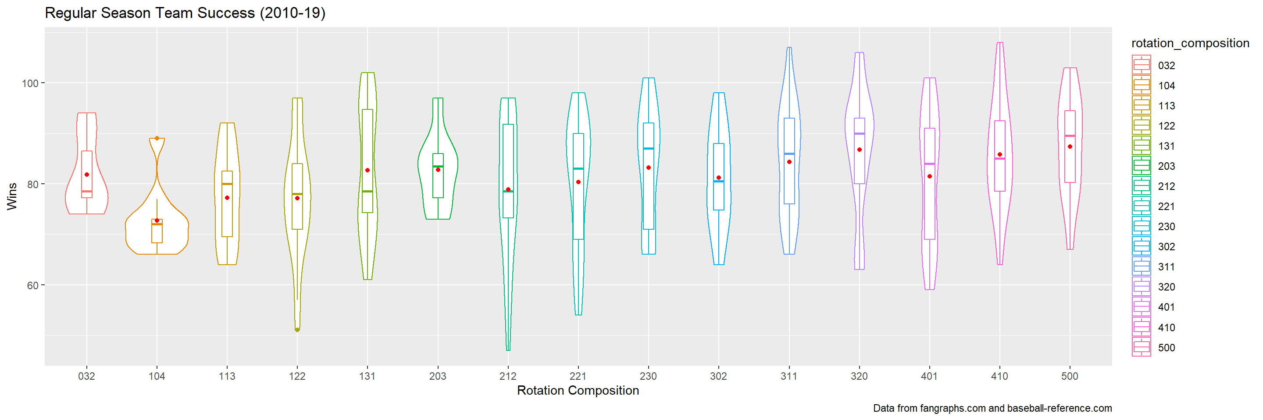

Slide 21
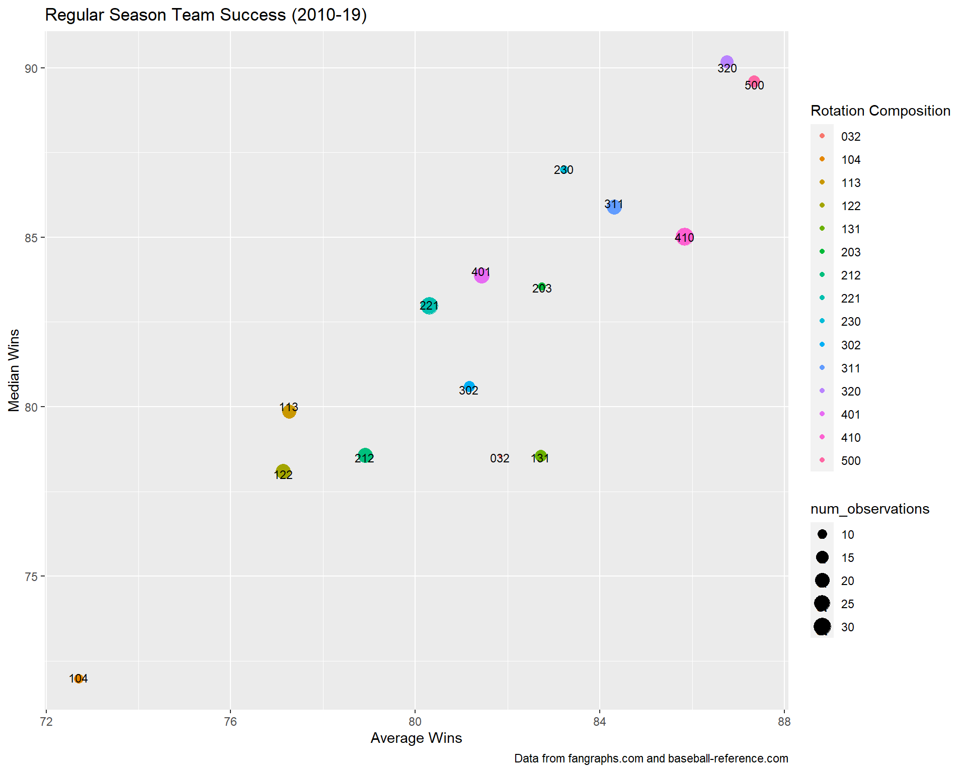

Slide 22
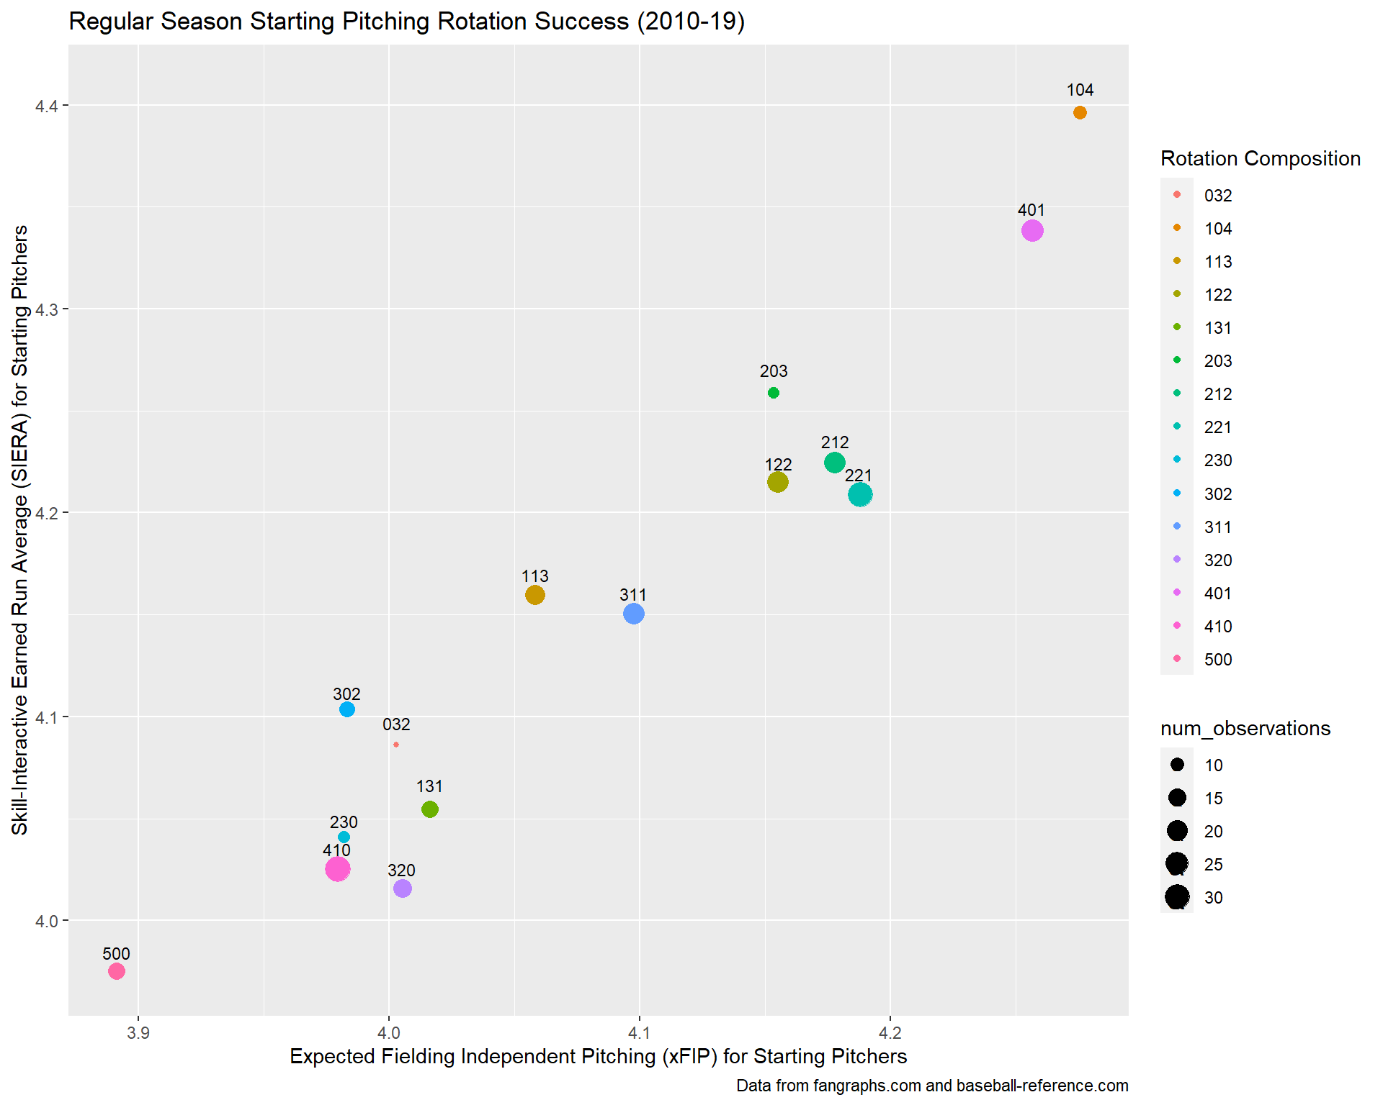

Slide 23
Average Success by Rotation Composition
After examining the data and the corresponding plots, it appears as if on average the starting pitching rotation represented by the key “500” seems to be the most successful, both in terms of team success and starting pitching-specific success

Slide 24
Looking Further Into Successful Teams
Rather than examining the average success among each of the different starting pitching rotations, I decided to further examine only the most successful teams over the past ten seasons in order to see if there were specific rotation compositions that were more conducive to achieving the highest levels of success

Slide 25
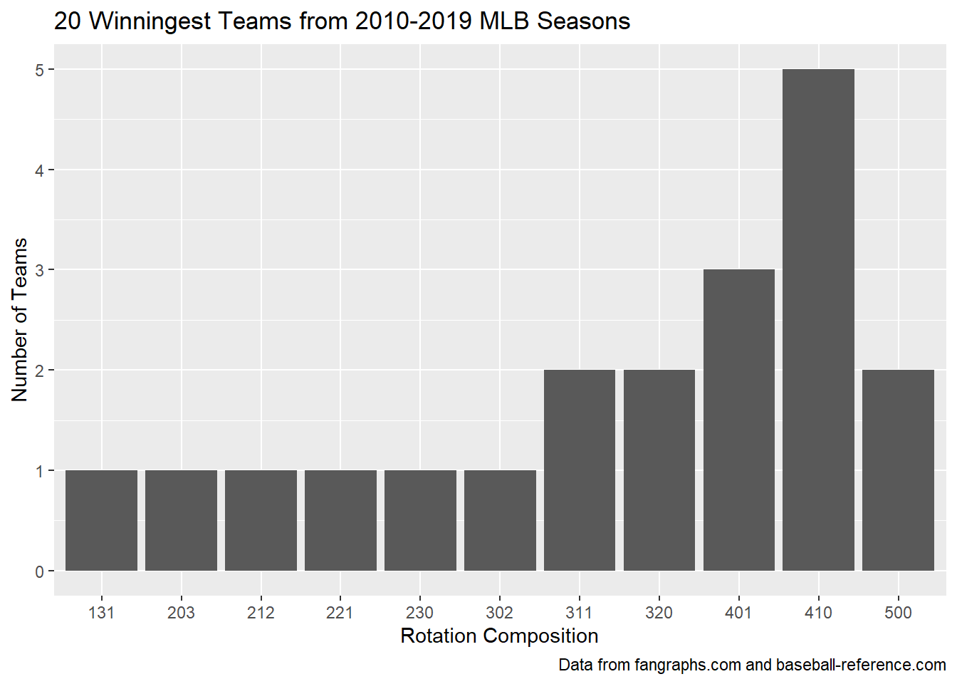

Slide 26
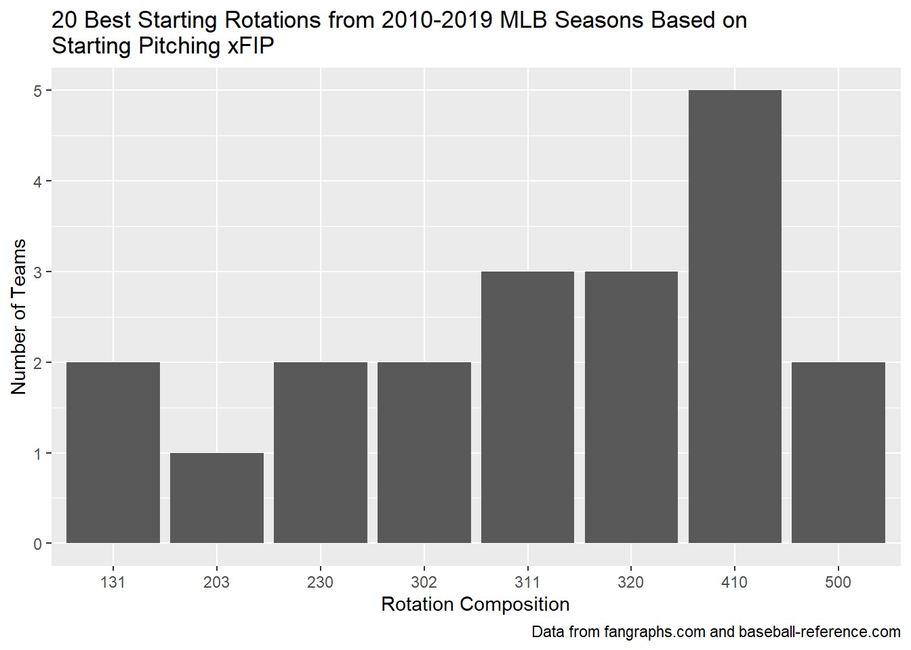

Slide 27
Compositions of the Most Successful Teams
After analyzing these graphs, it can be seen that among the teams which have been the most successful over the past ten seasons, both when it comes to team success and starting-pitching specific success, the starting pitching rotation composition represented by the key “410” is the most frequent

Slide 28
Final Conclusions
Whether we choose to more heavily value average success or proclivity to the highest levels of success, both rotation composition represented by the key “500” and rotation composition represented by the key “410” contain at least 4 starting pitchers belonging to Cluster 1 (“Power” Pitchers)

Slide 29
Final Conclusions
“Power” pitchers seem to be the most valuable for constructing MLB starting pitching rotations because rotations constructed of “Power” pitchers tend to perform the best on average
However, the presence of a “Control” pitcher in the rotation could increase the team’s and the starting pitching rotation’s ceiling in terms of making them more apt to reaching the highest levels of success

